Slide 1
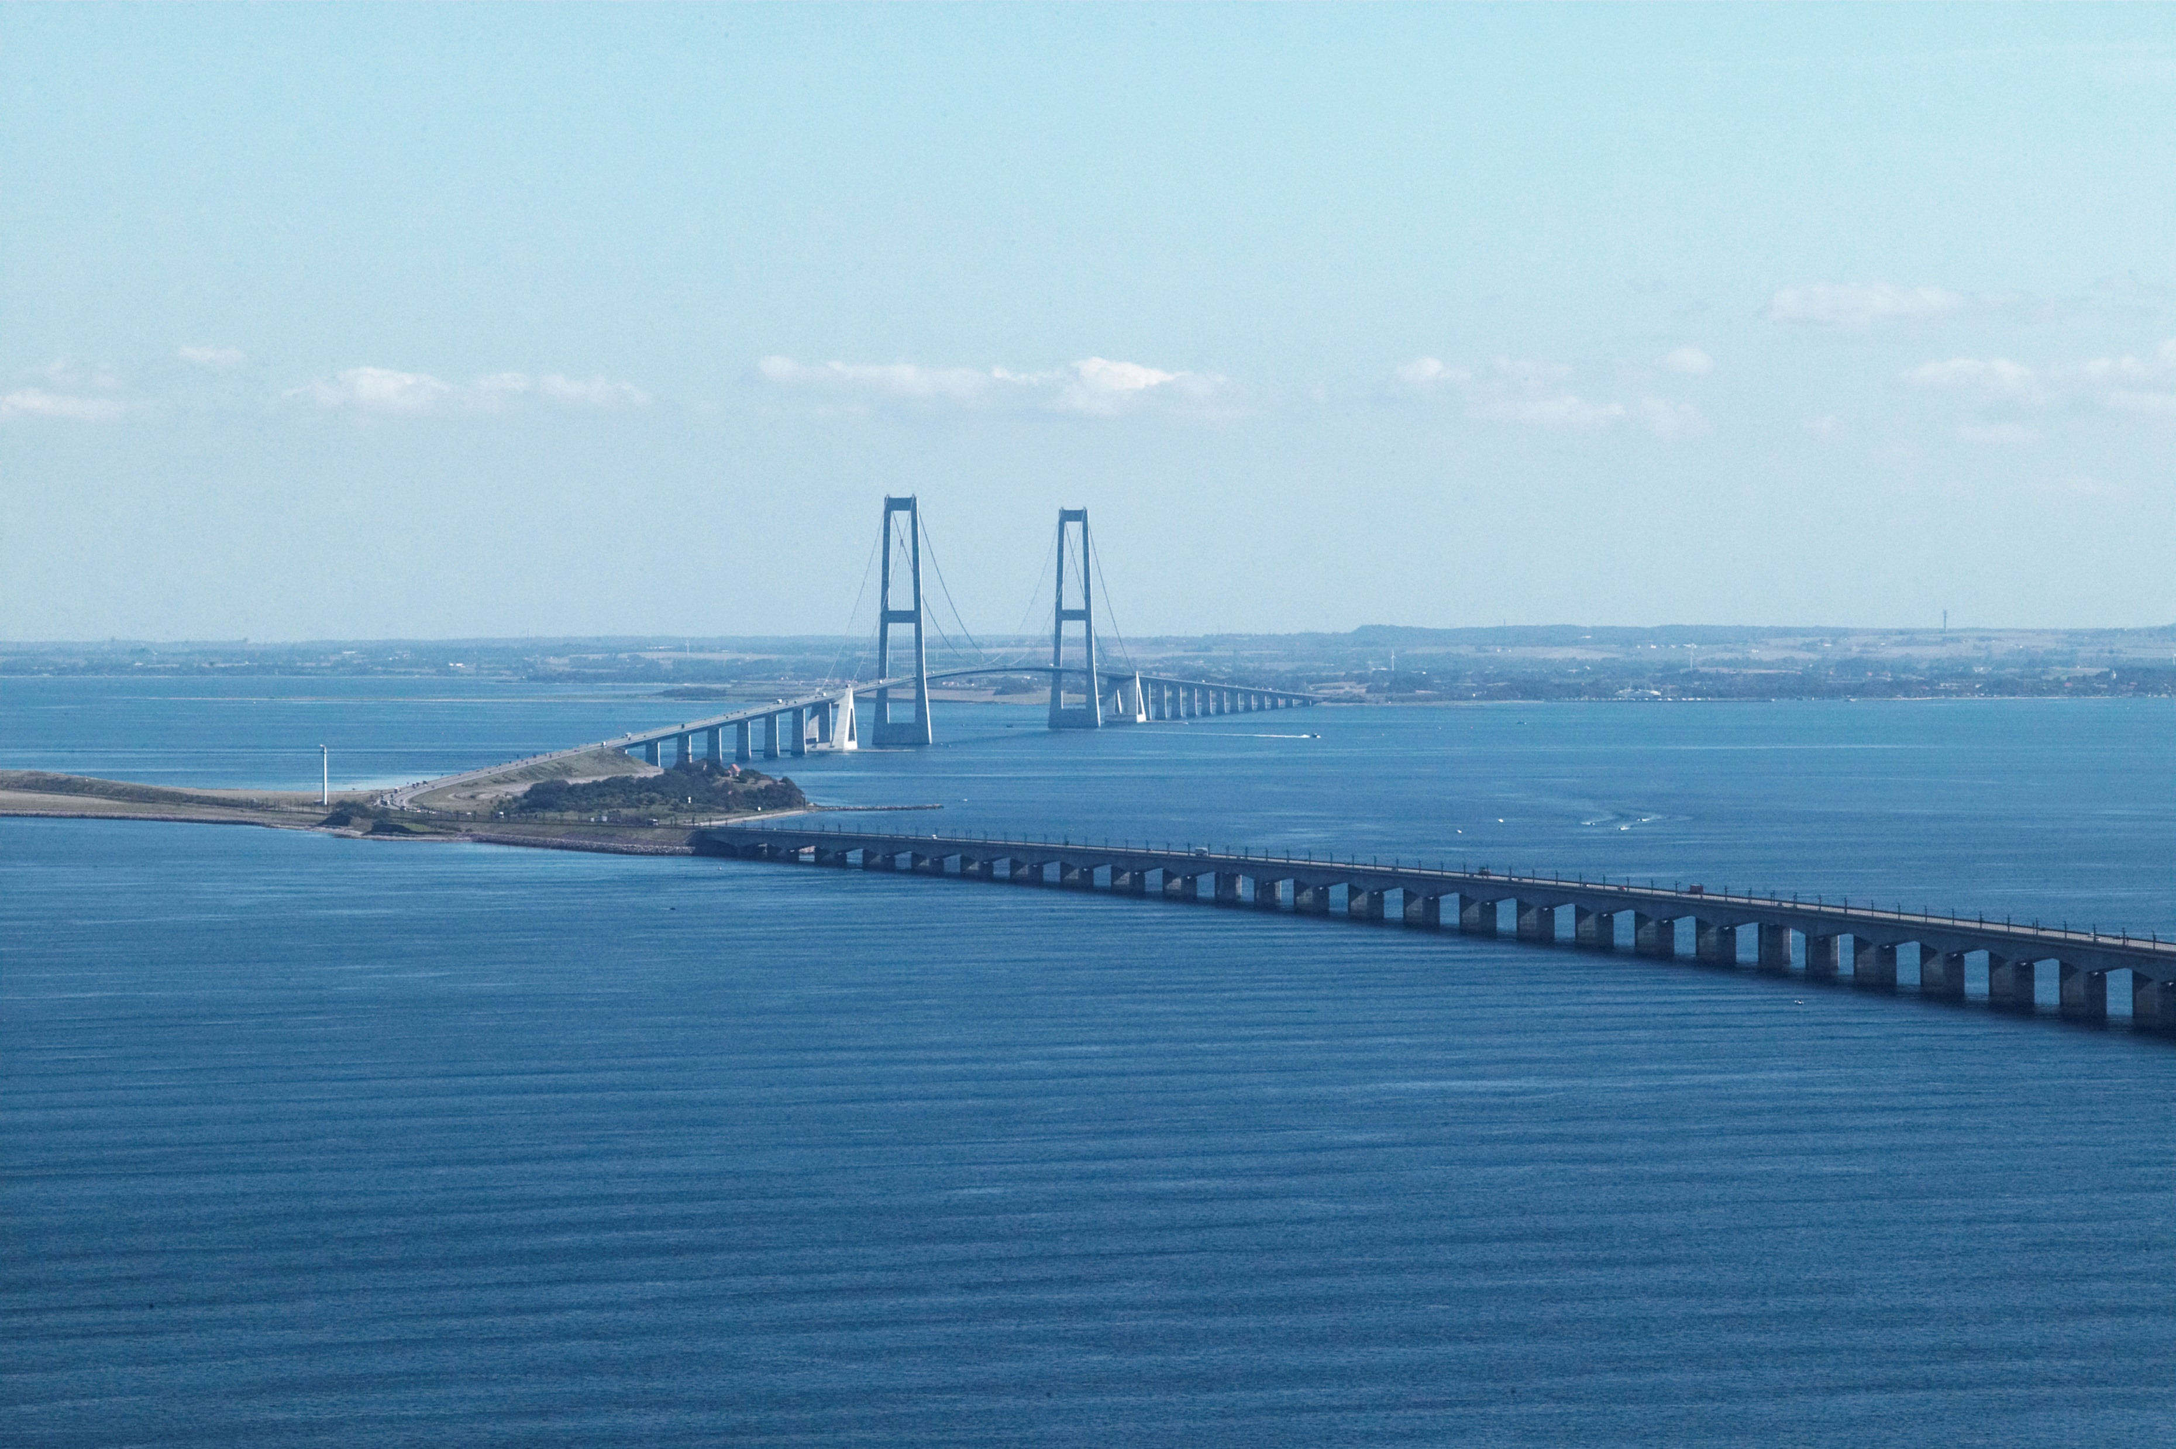
Geoteknikerens hverdag – Odense, 2021-10-14
Comparable experience for
large-scale bridge piers
- in memoriam PSK
East Bridge
Jørgen S. Steenfelt
COWI Denmark
(acknowledgement Per Sandgaard Kristensen – PSK 2019-02-21)
West Bridge
Notes:
Thanks to my friend & colleague who was instrumental in the data collection and had the West Bridge as his pet project (6.611 km long rial & motorway low bridge in bottom of photo; 110 m spans).
It was definitely his “baby” and although he passed away in February 21, 2019, he worked on data for West bridge as late as 23 January in order to ensure success on Storstrøm Bridge!!

Slide 2
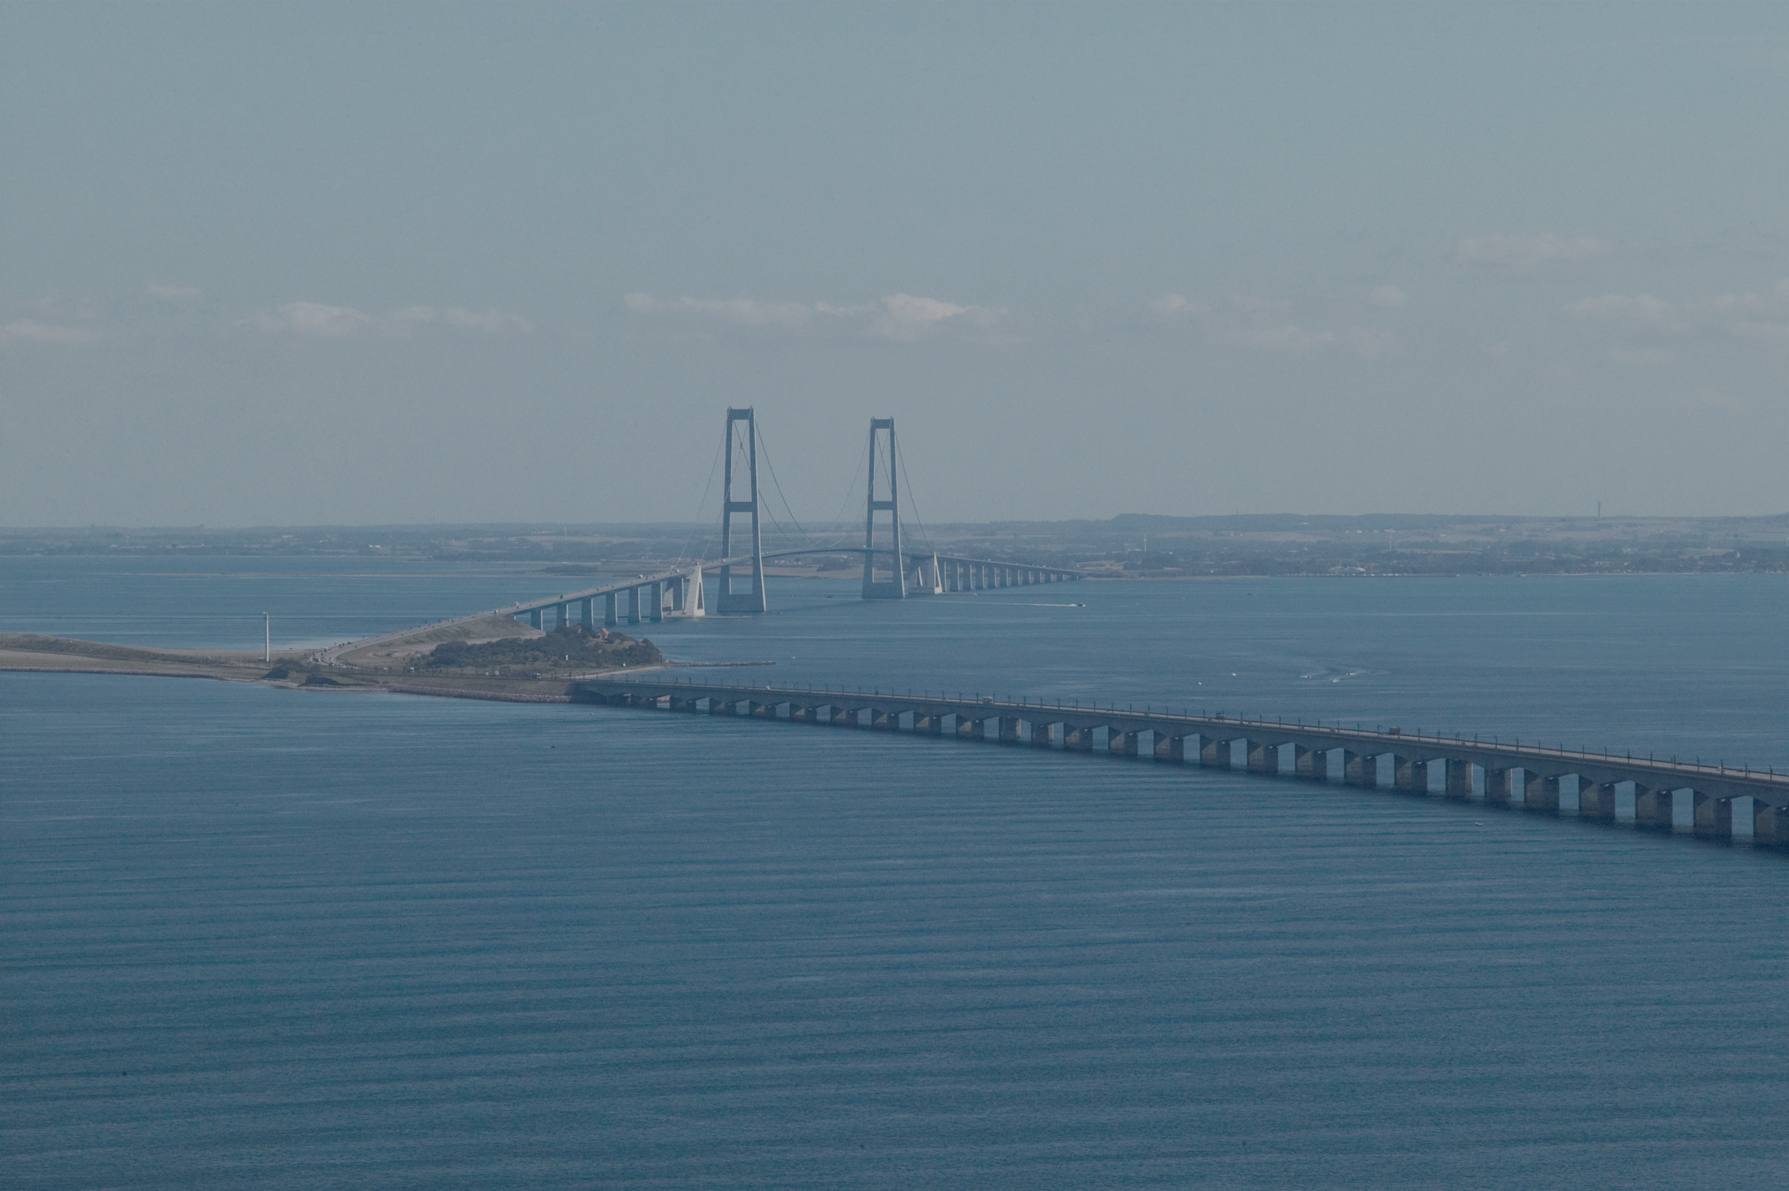
Outline
Prerequisite for direct foundation
Danish over-consolidated soils
Site characterization
Prediction & monitoring
Storebælt as backbone ➔ Storstrøm
Conclusion
Notes:
Most large-scale bridges cross water – which favours the concept of direct foundation and pre-casting.
The need for comparable experience:
In DK general experience that settlements and differential settlements (founded in (not high-plastic clay) till are small without problems with cracks in the structure. This knowledge was qualitative and only few structures had been monitored!
At the time of designing the west bridge it was realized that documented experience was needed, not least in the light of the common market with the advent of non-danish contractors on the scene.
Considering the importance of the structure (Storebælt Link per se) it was decided by Storebæltsforbindelsen to produce traceability in all phases of the project and to initiate comprehensive monitoring during and after project completion.
Note also that a lot of “near” nice-to-know research was instigated!
Thus, both West Bridge and East bridge data now serve as comparable experience for generations following the “owners” of the “Storebælt experience”.

Slide 3
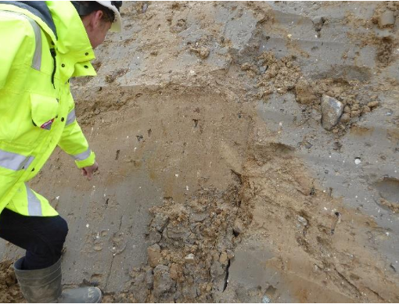
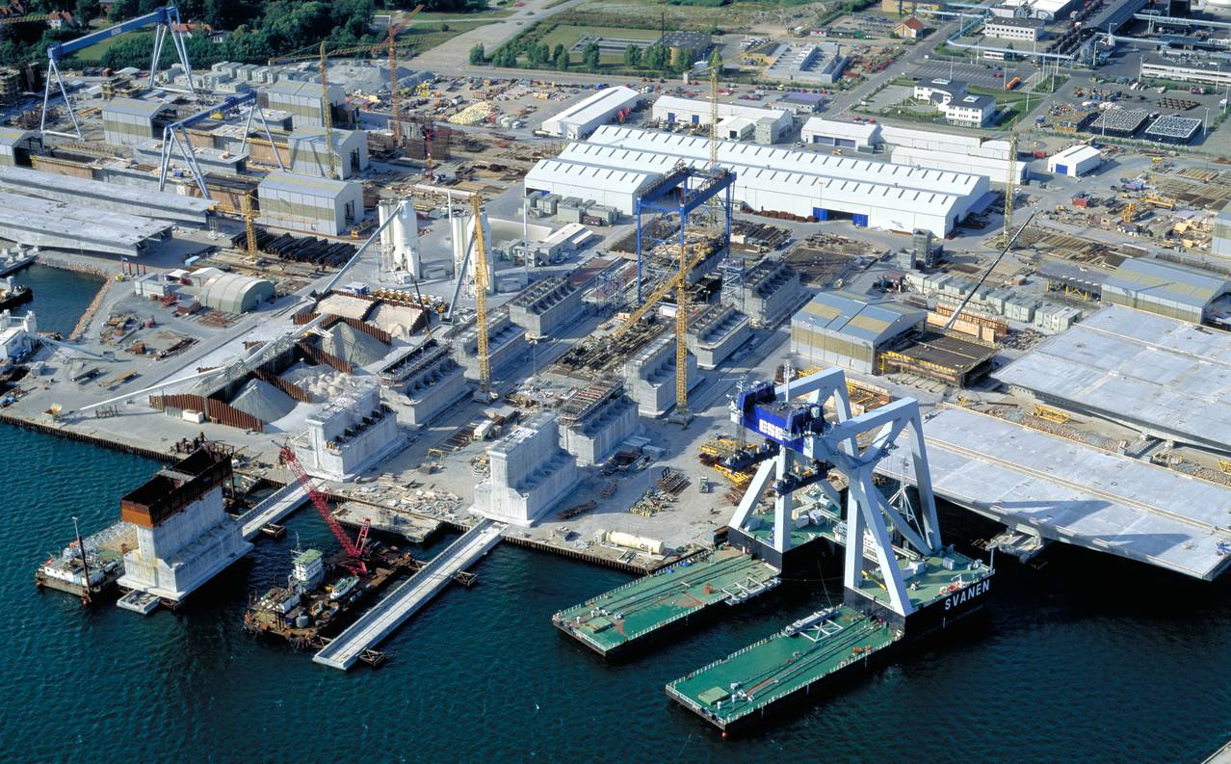
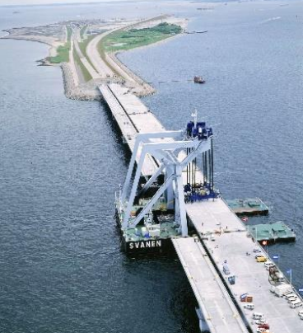
Prerequisite for (off shore) direct foundation
Competent soil
@ shallow depth
Pre-fabrication facilities
Powerful marine spread
Reliable site characterization
Match between
sub- & superstructure
“Comparable experience”
Notes:
Competent = strength and manageable settlements
- prefabrication honed by numerous infrastructure project in DK and abroad
- soil structure interaction needs attention
- for foundation on clay till ULS are mostly decisive
but obviously careful check for large-scale structures

Slide 4
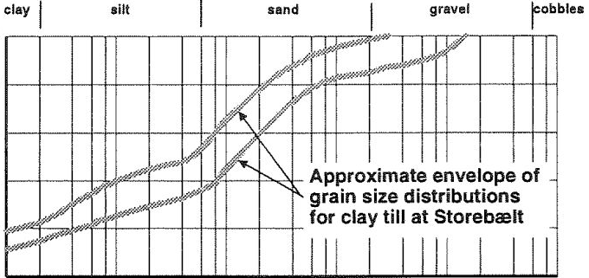
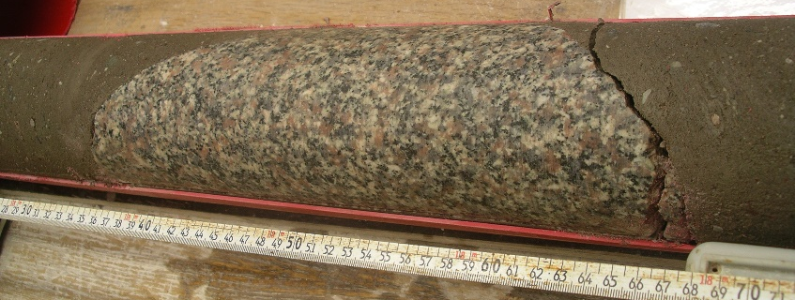
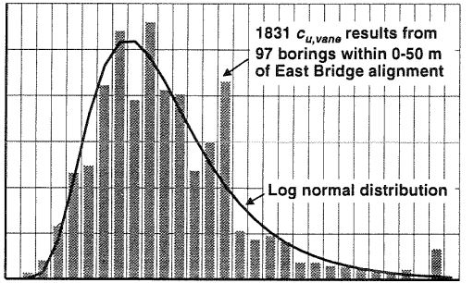
Danish over consolidated clay till
Wide range of grain sizes
"..may contain cobbles and boulders"
Wide range of s_{u,vane} values
Using CPTu, triax, DS & SHANSEP
c_{u,C} = 0.42 σ'_{v} OCR^{0.85}
c_{u,DS} = 0.86 c_{u,C}
c_{u,E} = 0.71 c_{u,C}
s_{u,vane} = 0.88 c_{u,C} (~ 1.0 DK practice)
s_{u,CPT} = q_{c}/(10-12)
100
50
0
%
<d
0.01 1 100
d (mm)
12
8
4
0
0 350 700
s_{u,vane} (kPa)
Notes:
Formerly mostly vane testing but Storebælt introduced CPT at large scale
- Peter Wroth giving lecture on CPT: what is all the fuzz about? Your soils are extremely competent
- in fact many CPT tips were destroyed in the Storebælt campaign
- the sand/gravel layers are assumed to have better properties compared to the clay till
and hence the same parameters are used for convenience

Slide 5
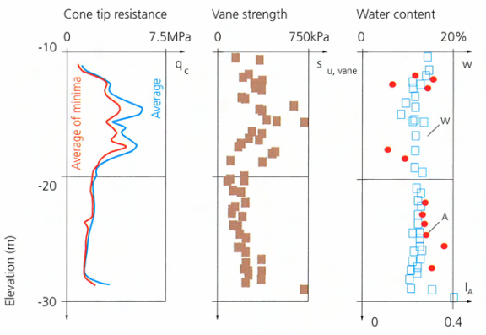
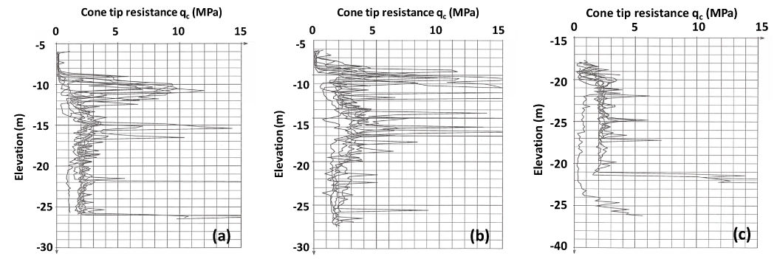
Site characterization
Boreholes (GeoBorS)
- sampling
Vane, SPT, CPTu
Advanced lab-testing
- oedometer (E_{oed,t} = a + b σ’_{red})
- triax (calibration of N_{kt})
Comparable experience
- use of classification
Average CPT values over footprint (composite)
No merit in using up to 15 individual points per pier
Notes:
As seen above GeoBor S with coring allows for excellent samples for advanced testing
due to variability single CPTs or boreholes may be misleading as seen in the composite plots
All the spikes are due to sand/gravel/stones – no filtering applied here

Slide 6
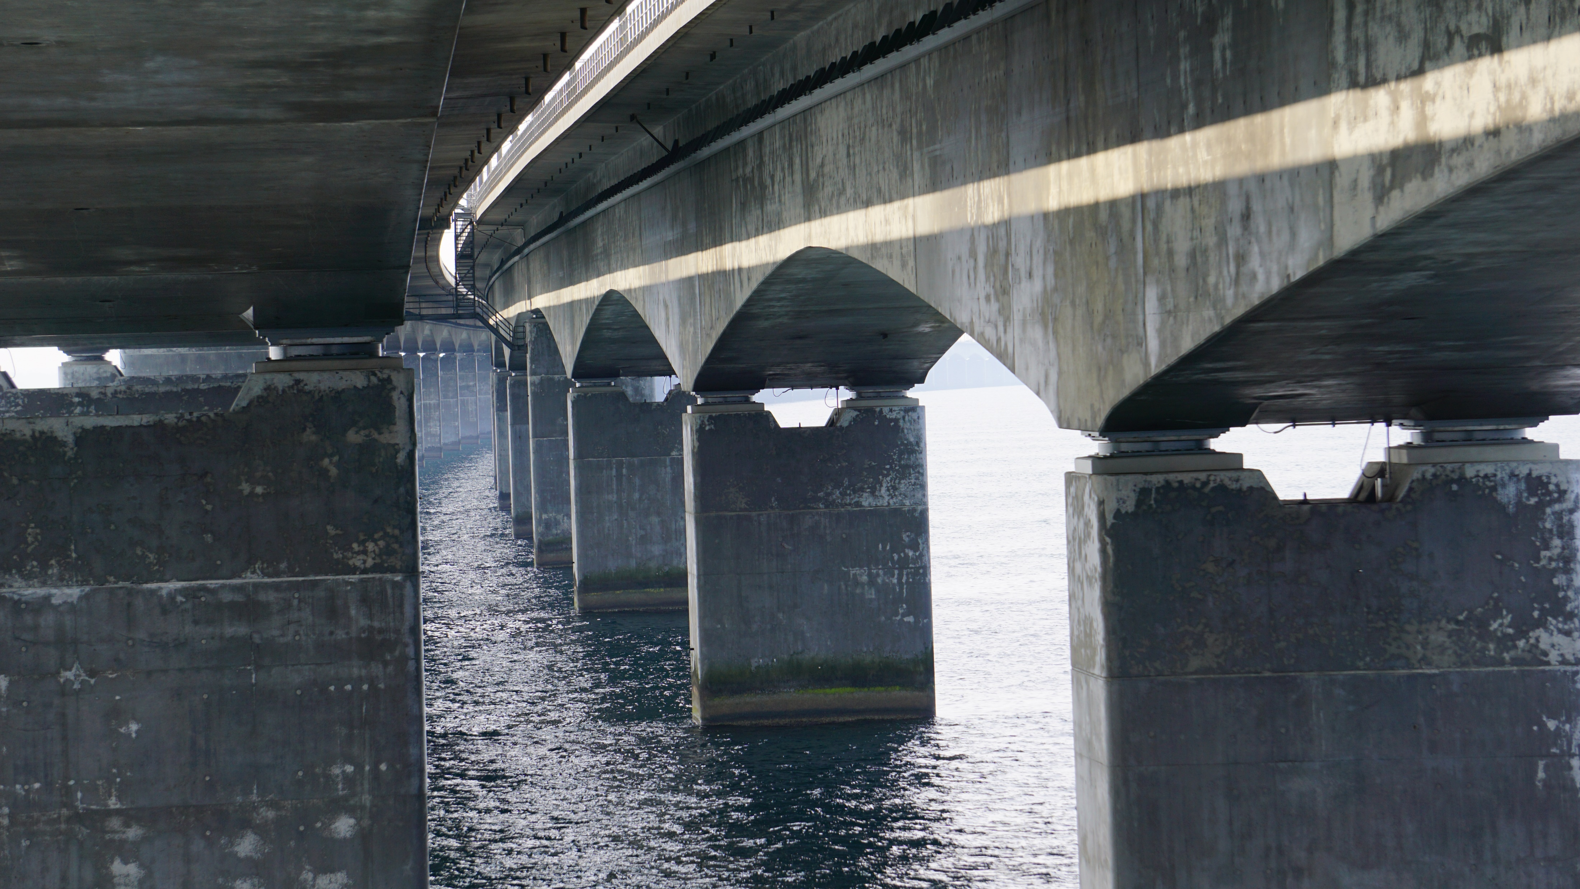
Prediction and monitoring
Original in-depth evaluation and prediction: PSK April 2013
Notes:
First publication on West Bridge settlements 1995 by PSK
Re-interpretation and predictions for 2100 by PSK April 2013.
Long discussions early 2019 with respect to using the “comparable data” data for Storstrøm Bridge validator and checker!

Slide 7
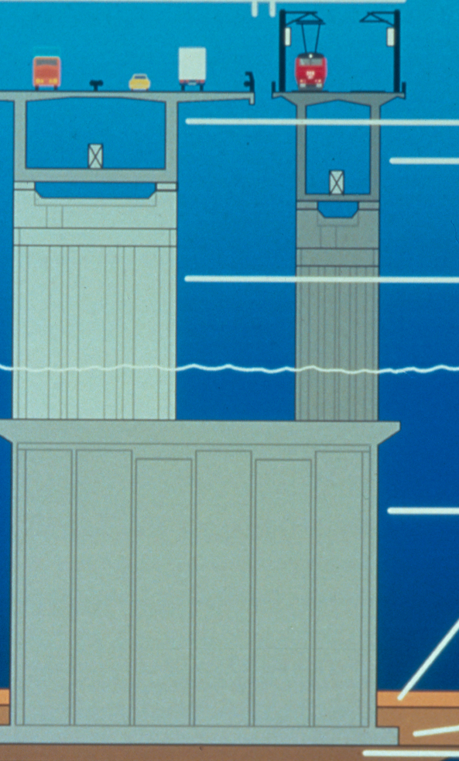
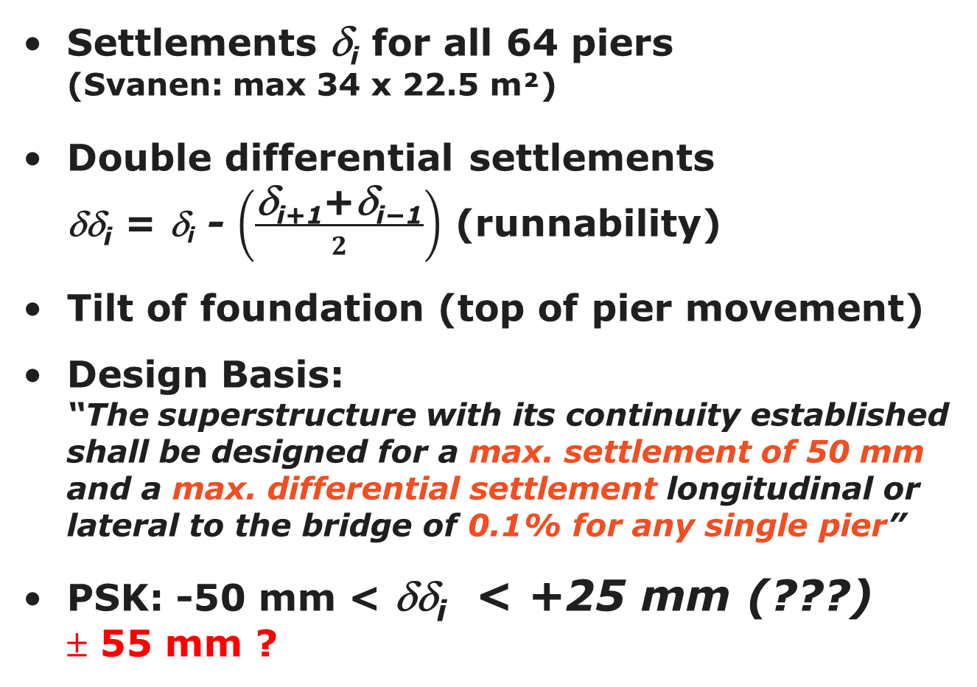
110 m
Prediction
δ_{i-1}
δ_{i+1}
Settlements δ_{i} for all 64 piers
(Svanen: max 34 x 22.5 m²)
Double differential settlements
δδ_{i} = δ_{i} - $\left(\frac{\text{δ}\text{i}\text{+1}\text{+}\text{δ}\text{i}\text{−1}}{2}\right)$ (runnability)
Tilt of foundation (top of pier movement)
Design Basis:
“The superstructure with its continuity established shall be designed for a max. settlement of 50 mm and a max. differential settlement longitudinal or lateral to the bridge of 0.1% for any single pier”
PSK: -50 mm < δδ_{i} < +25 mm (???)
± 55 mm ?
δ_{i}
δδ_{i}
27-55 m
Notes:
Originally difficulties with measurement over 6 km (error accumulation)
helped by GPS subsequently
Maximum size of pier footprint due to Svanen capacity
PSK evaluation of Design Basis is incomprehensible. We never got the chance to solve this issue.

Slide 8
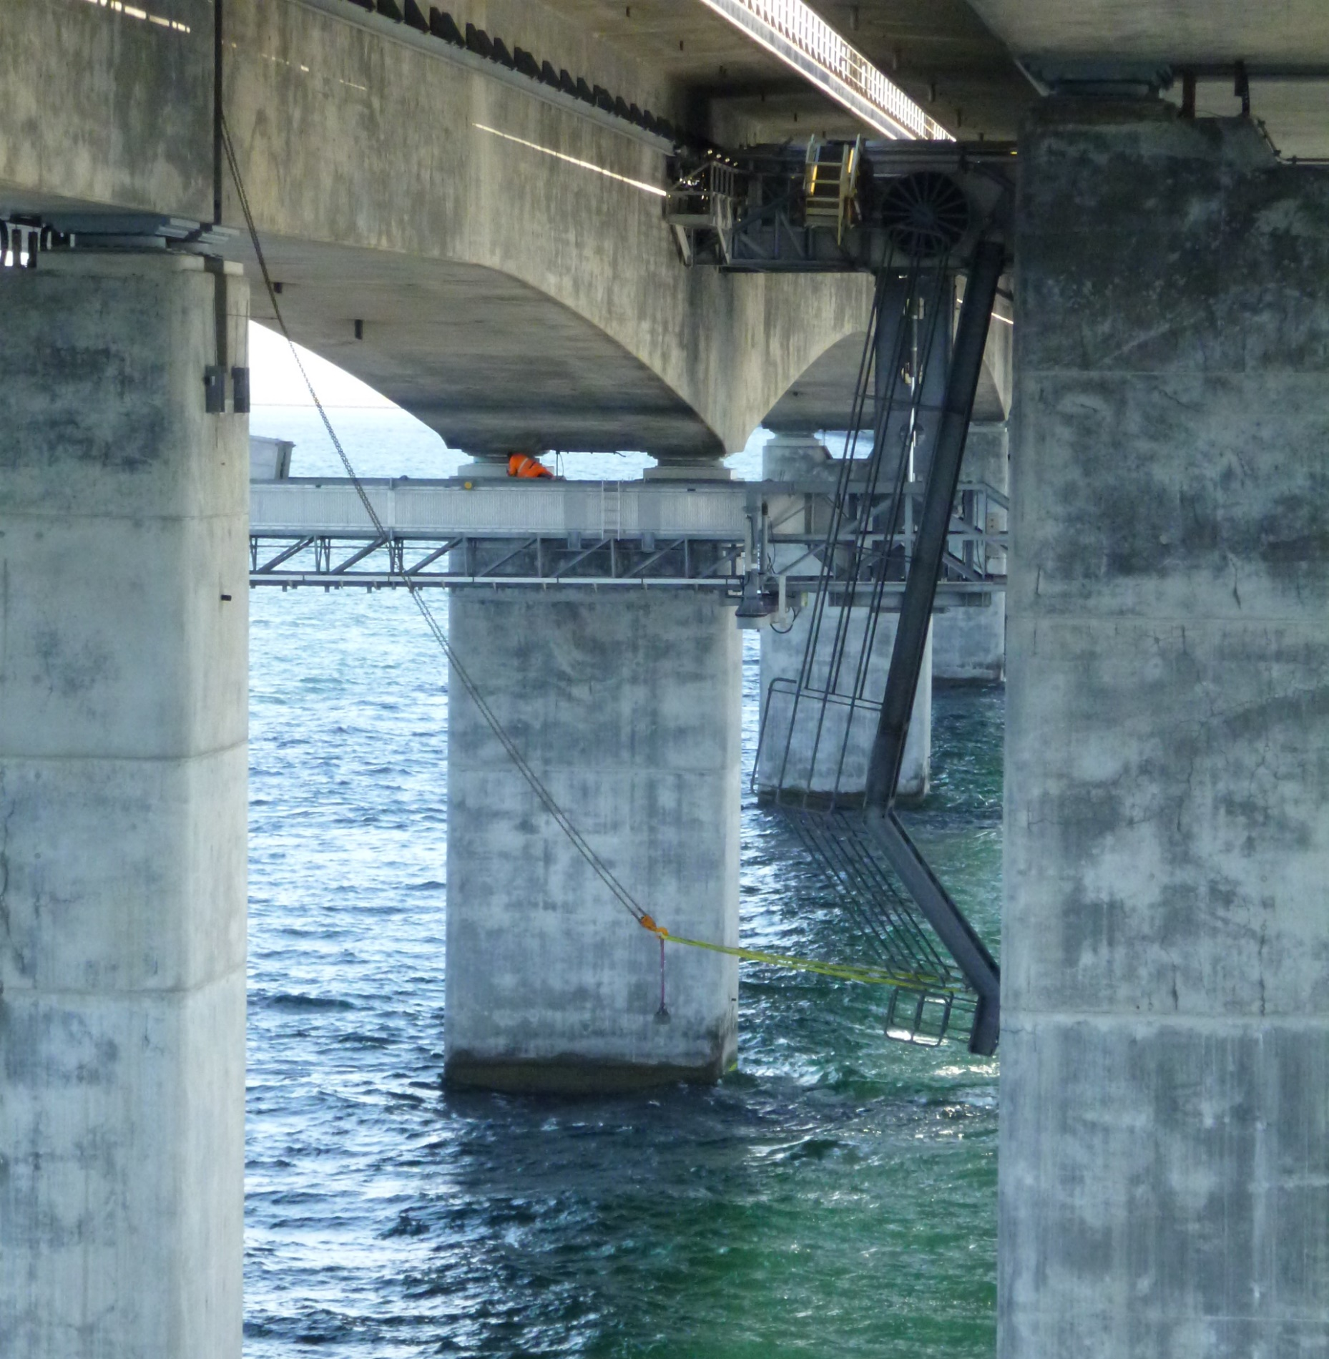
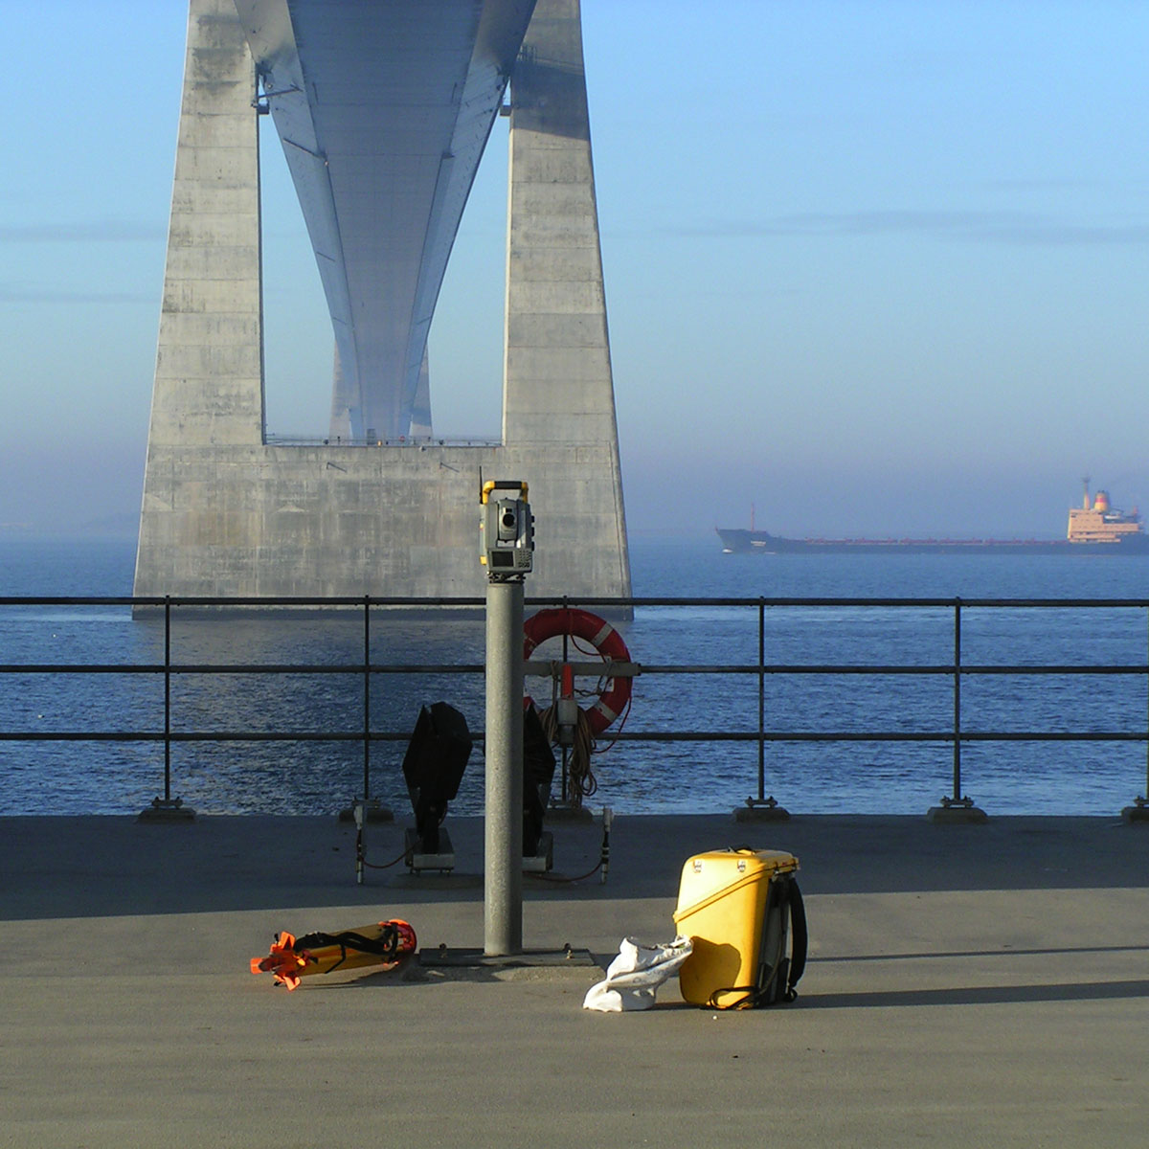
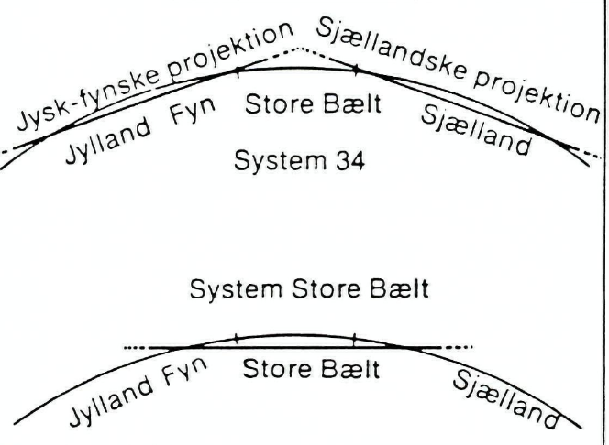
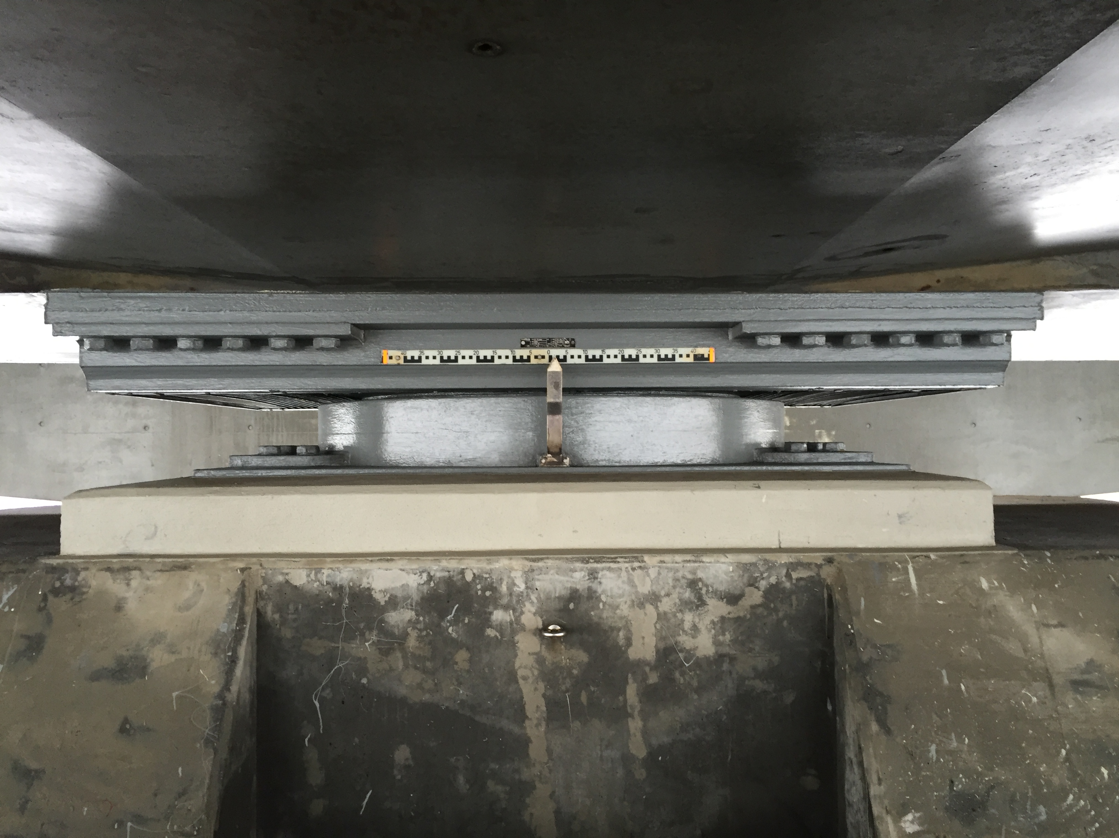
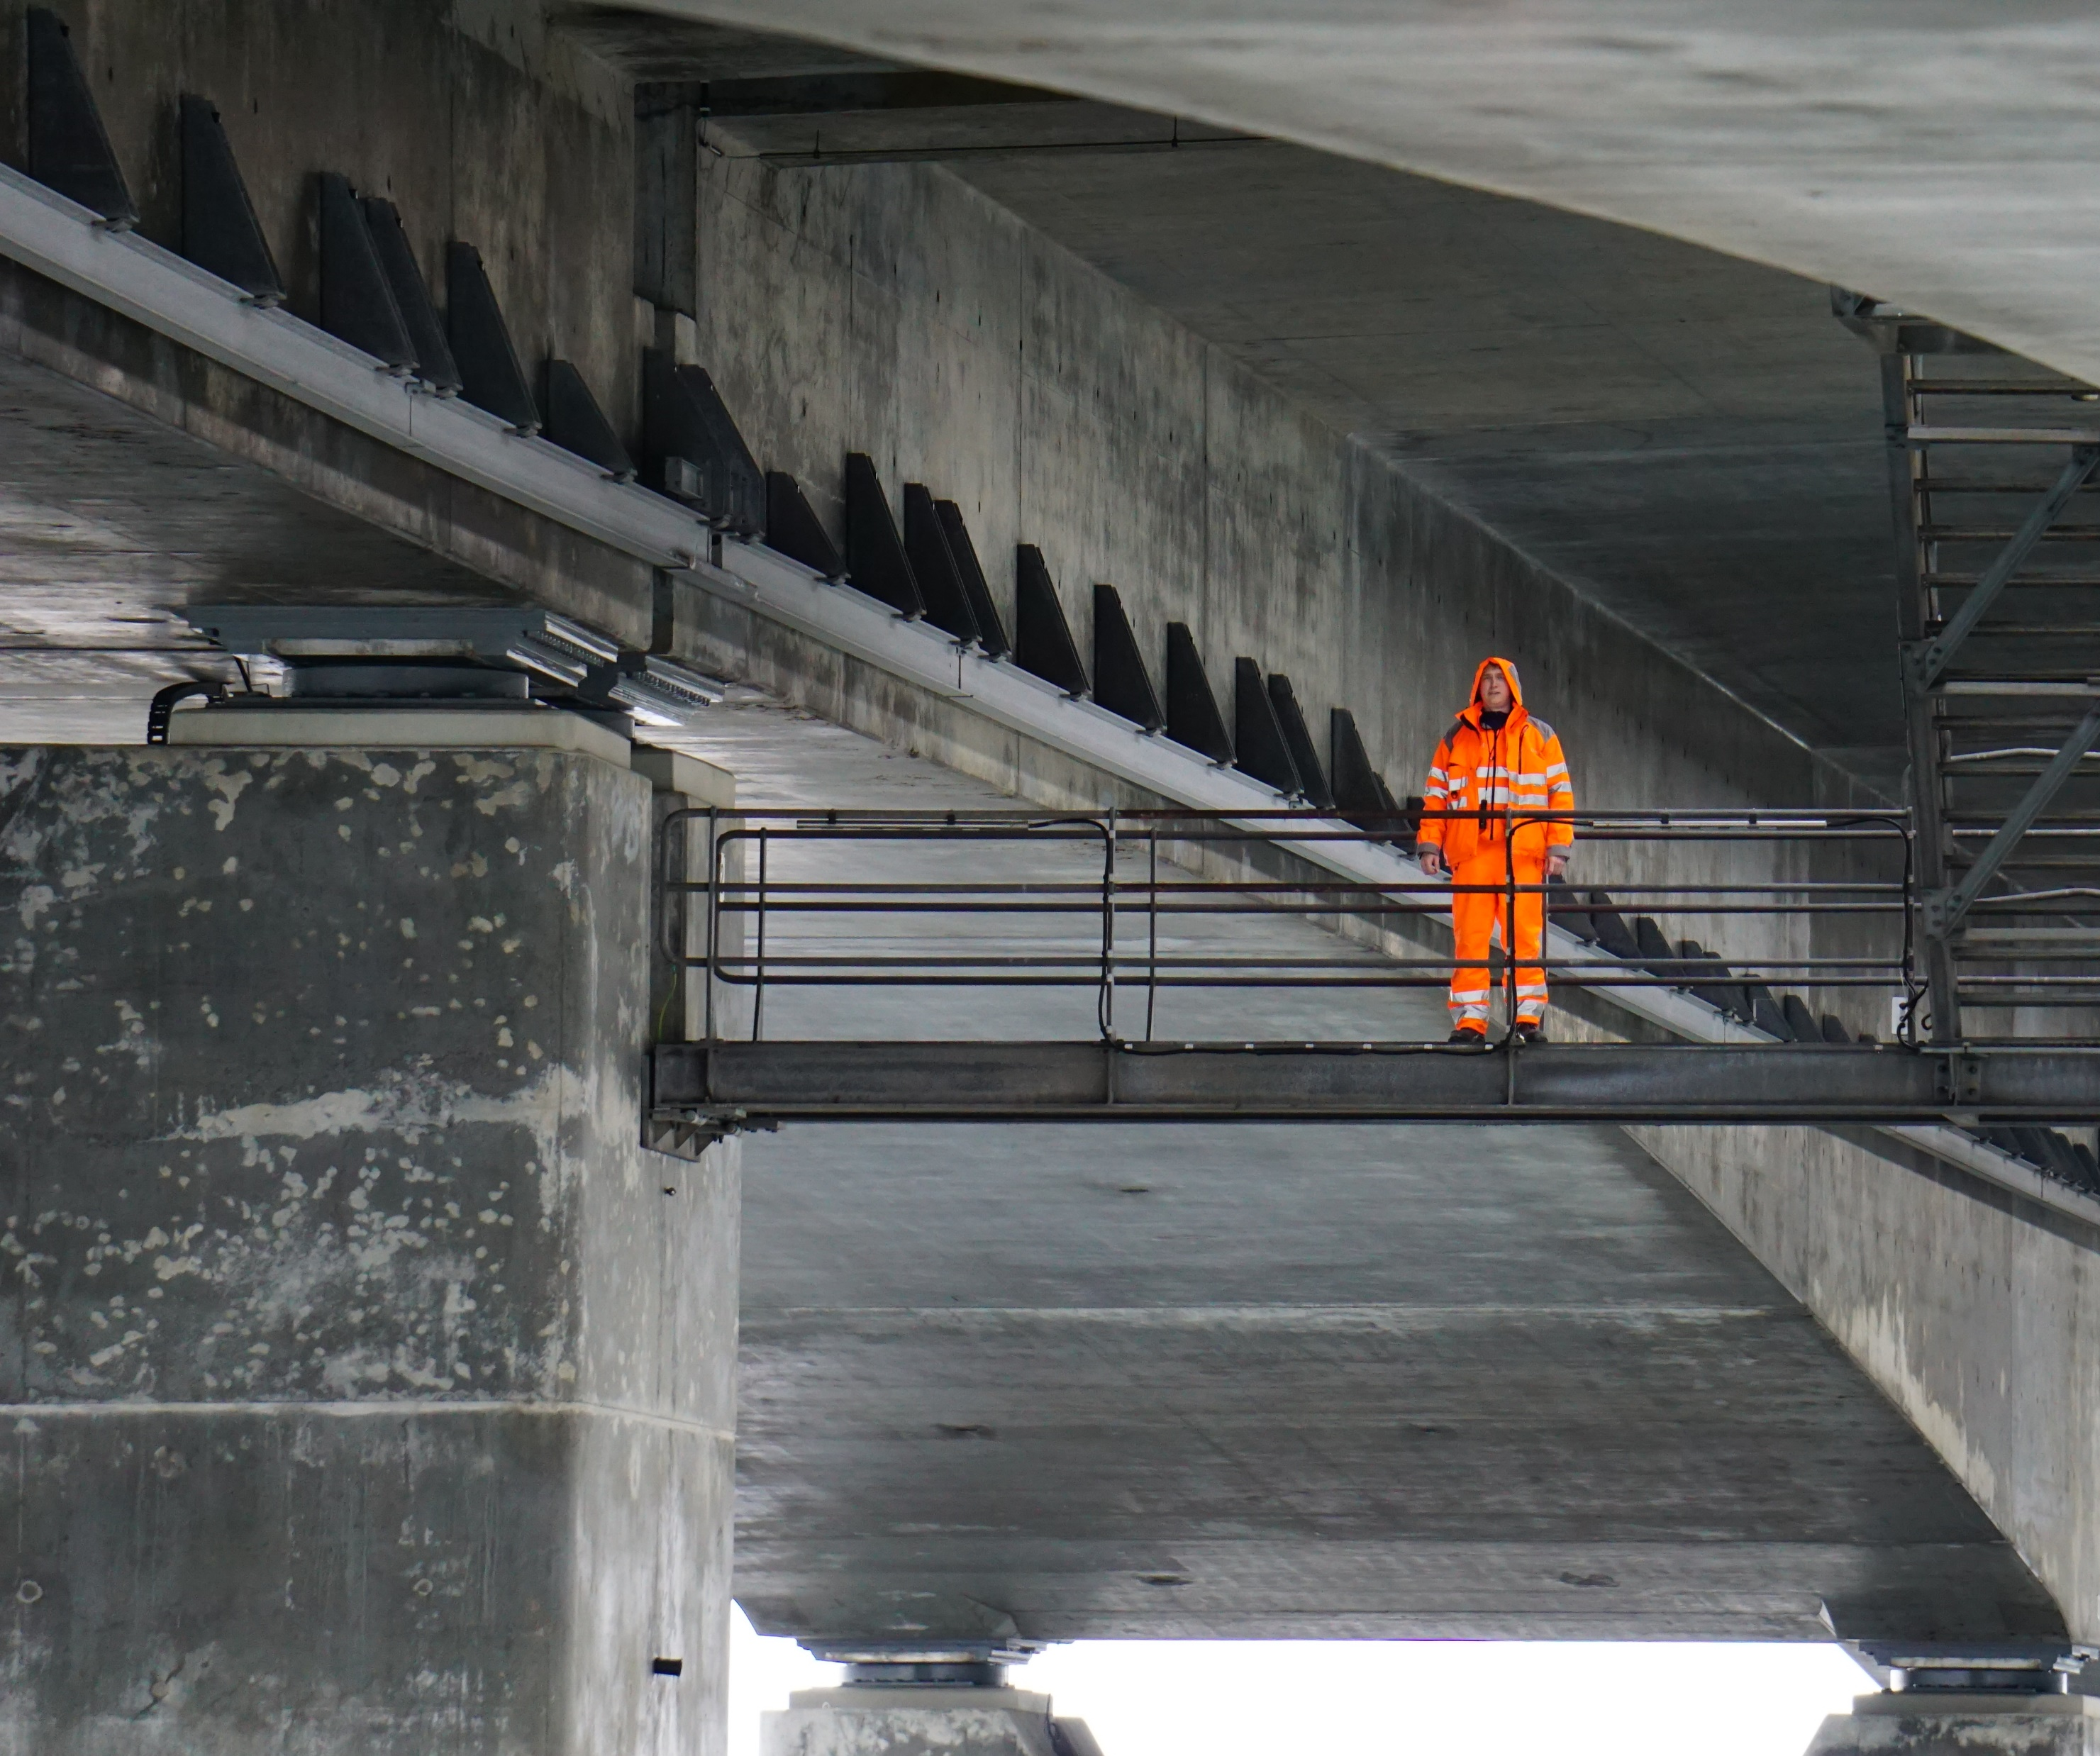
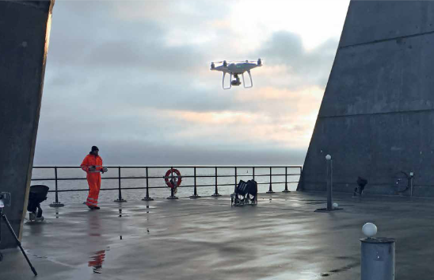
Monitoring (January 1994 to date)
Levelling & inclinometer
Check of bearings/maintenance
Now on-line inclinometers
& drones
Notes:
Originally difficulties with measurement over 6 km (error accumulation)
helped by GPS subsequently
after 2014 on-line monitoring of tilt and inspection reports by drones!

Slide 9
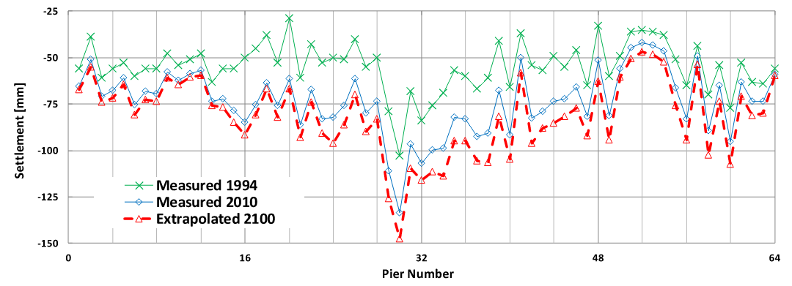
Monitoring and extrapolation - settlements
1994 @ hand-over Client (δ negative is settlement here!)
2100 @ expected life-time (due to rate of creep: 6 to 20 mm/lct)
Notes:
initial measurement (true zero) difficult as significant time difference between railway and road girders and establishment of girder continuity
variation due to soil variability

Slide 10
Monitoring and extrapolation - creep
Best fit
mm/lct
Notes:
-linear in log time scale – best fit line to measured settlement points
Pier 2 & 64 are abutments where calculated settlements were not easily obtainable (available)

Slide 11
From hand-over 1994 to estimate @ year 2100
Notes:
-linear in log time scale – best fit line to measured points

Slide 12
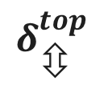

Tilt monitoring
Coordinate based:
error accumulation
Inclinometer reliable
Random distribution
Slight increase in time
Tilt < 0.1% (no concern)
Δδ_{corner-corner} ∼ 0.33δ_{mean}
δδ ^{top} (20 – 25 mm) ➔
check of bearings
Now automatic track monitoring
$$δ_{⬄}^{top}$$
$$δ_{}^{top}$$
Notes:
Need for check of bearings dictated by relative displacement of pier top compared to neighbouring piers (double differential)
variation due to soil variability

Slide 13
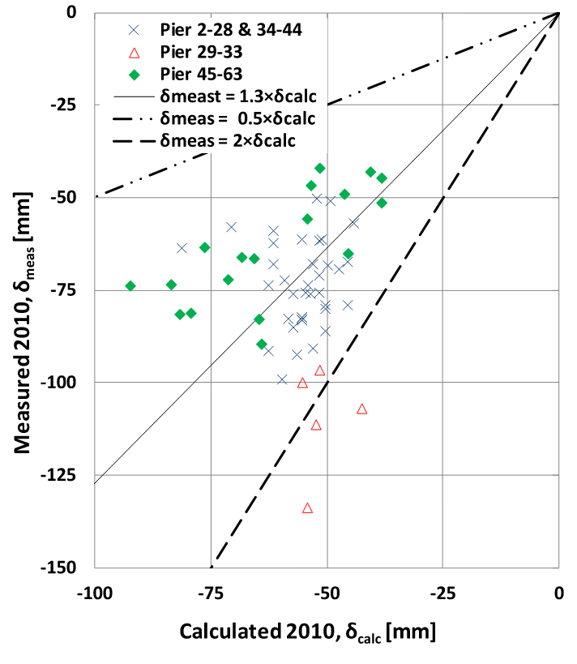
How are predictions?
Generally fair agreement
- better than factor 0.5 to 2
Piers 29 to 33
- realized in advance
- special attention
- high stress relaxation
upwards flow @ front glacier
Slight overest. stiffness?
Settlements not decisive
Double differential OK
Horizontal displacements random (tilt < 0.1%)
Notes:
- Very valuable insight for future projects

Slide 14
Extrapolated double differential – (δδ)_{i}
@ year 2100
PSK curve fitting
Still below strict limits:
+25 to -50 mm
No correction in bearings
Next full scale monitoring: 2026

Slide 15
Extrapolated double differential – (δδ)_{i}
Notes:
The extrapolation comes with an uncertainty. Both methods provide values well below plus/minus 50 mm double differential settlement
The more straight-forward extrapolation gives higher values (factor 1.6) but the regression coefficient is very low (<0.6).

Slide 16
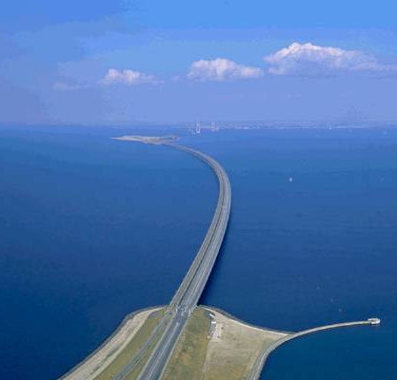
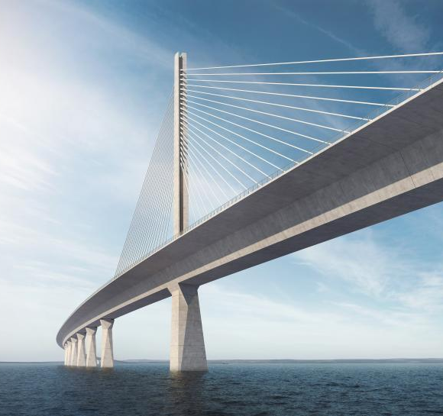
Conclusions
“comparable experience”
➔
Notes:
Establishing and using “comparable experience” are the key issues and outcome of this exercise.

Slide 17
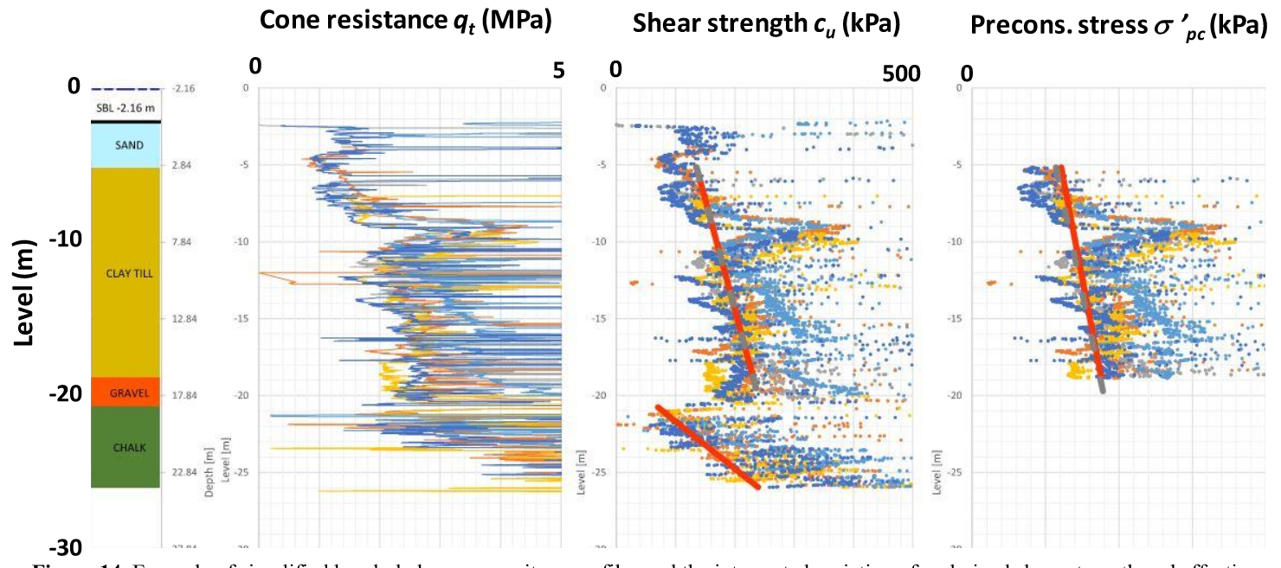
Conclusions (1)
Monitoring data serve as back-bone data in the future
Comparable experience established for future projects
CPTu as main tool in site characterisation for Storstrøm Bridge
Base line
Notes:
- Bold assumptions (red lines) provide contractual base line between Contractor and owner
Using SHANSEP for excavation verification CPTs proved accuracy of base line predictions!
- Re-iteration of the value of the documented Storebælt experience.
- No claims for differing soil conditions

Slide 18
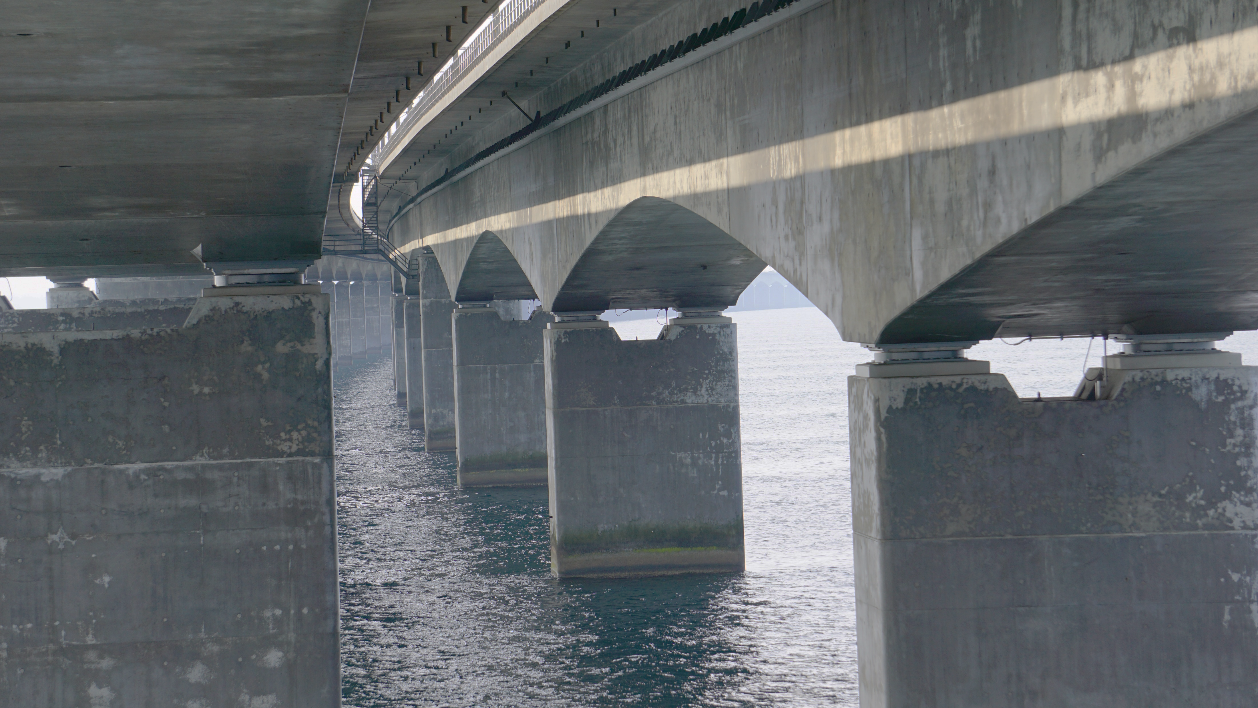
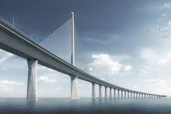
Conclusions (2)
No merit in detailed differentiation
Settlements manageable
- within “normal” range of predictions
- δδ without consequence to date
Tilt of no consequence
Storstrøm Bridge
- Baselines to handle
”unforeseen ground conditions”
- max stress < 75% σ’_{pc} (reduces δ & δδ)
Monitoring should be obligatory!
Notes:
Trust is good control is better!
Sherlock Holmes in “A scandal in Bohemia”:
It is a capital mistake to theorise before one has data. Insensibly one begins to twist facts to suit theories instead of theories to suit facts.”

Slide 19
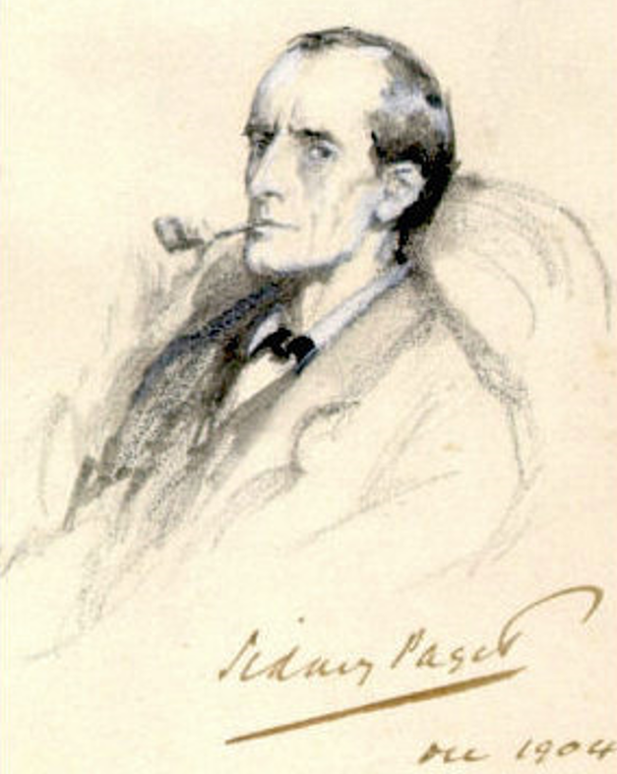
Food for thought
Sherlock Holmes in
“A scandal in Bohemia”:
It is a capital mistake
to theorise before one has data.
Insensibly one begins to twist facts to suit theories
instead of theories to suit facts!

